Slide 1

RISK DOMINATION BUILD 1 TEAM U7 SOEN 6441 FALL 2023 Submitted to: Dr. Amin Ranj Bar
40261785 – ABHISHEKKUmar MAVANI
40226105 - AKSHARKUMAR PATEL
40230415 - KARNIK SHAH
40231114 - SHREY Agrawal
40274495 - SHUBH thummar
40265305 - UMANG savlA

Slide 2
FLOW OF THE PRESENTATION
1. Architectural design of the Project.
2. Class Diagram of Build 1.
3. Coding Conventions and tools used.
4. Demonstration of functional requirements.

Slide 3
ARCHITECTURAL DESIGN
UPDATE
ACTION
CONTROLLER
USER
MODEL
CONTROLLR
VIEW
MODEL
VIEW
FEEDBACK
FEEDBACK
MODEL – VIEW – CONTROLLER ARCHITECTURE

Slide 4
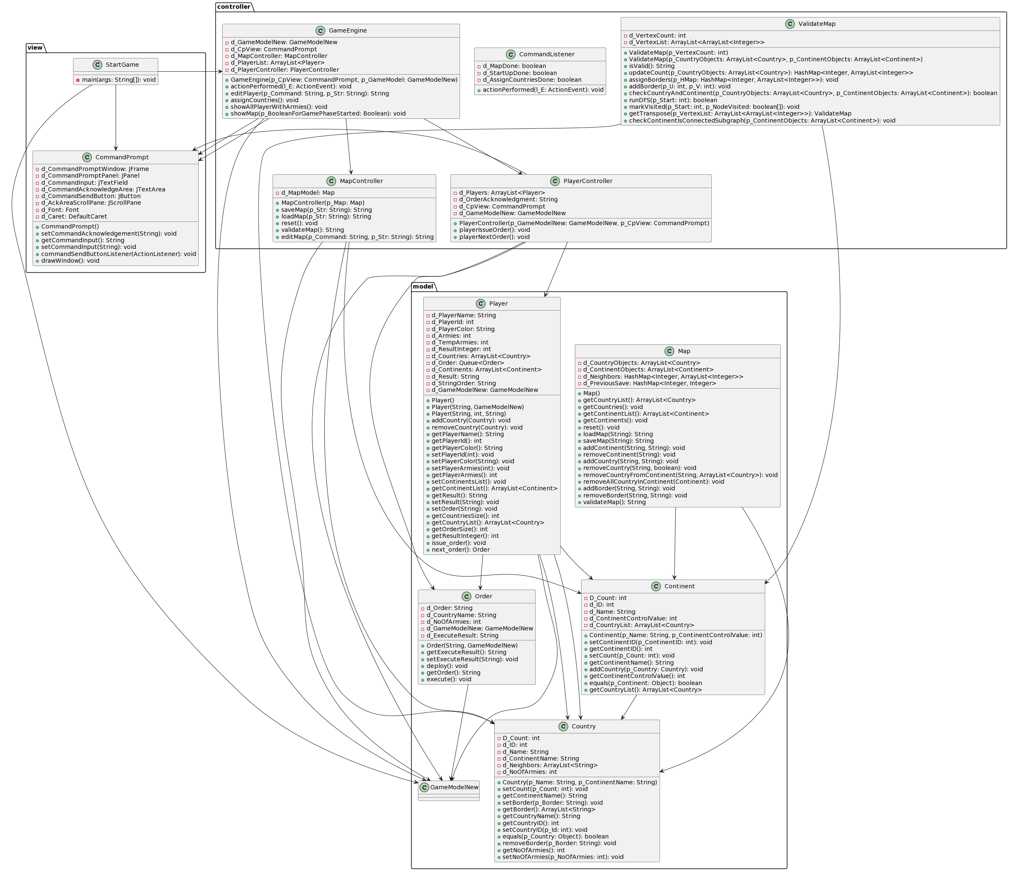
CLASS DIAGRAM

Slide 5
CODING CONVENTIONS AND TOOLS USED
Class names in CamelCase that starts with a capital letter.
Data members start with d_ .
Method parameters start with p_ .
Local variables start with l_ .
Static members start with a capital letter, non-static members start with a lower case letter.
For version control we have used VSCode and Github.
For documentation we have used Javadoc and PlantUML.
For unit testing we have used JUnit.
For Continuous Integration we have used Github Actions.

